Slide 1
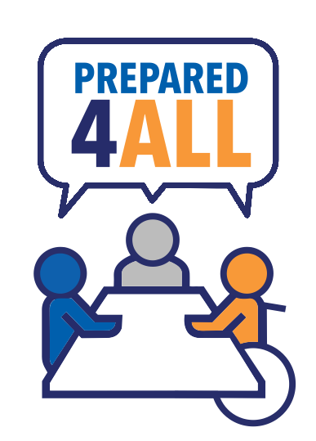
Prepared4ALL: Disability Organizations Getting A Seat at the Local Emergency Planning Table
A project of the National Center on Disability in Public Health and the Association of University Centers on Disabilities (AUCD)
Prepared4all@aucd.org
May 13, 2021

Slide 2
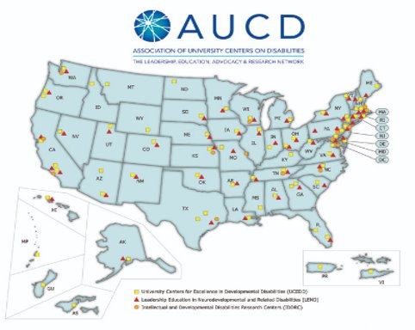
Prepared4ALL Work with us!​
AUCD Network Centers are in every state and territory.​
Mission: Advance policies and practices that improve the health, education, social, and economic well-being of all people with developmental and other disabilities, their families, and their communities
AUCD network helps people with disabilities overcome barriers to inclusion and wellness through research, training, service and advocacy.

Slide 3
Prepared4ALL
Mission: Capacity-building for local disability organizations to develop relationships with local government to increase disability inclusion in emergency and public health preparedness planning
Primary audience: Disability organizations​
Secondary audiences: emergency managers, public health professionals, healthcare professionals

Slide 4
“All response is local”

Slide 5
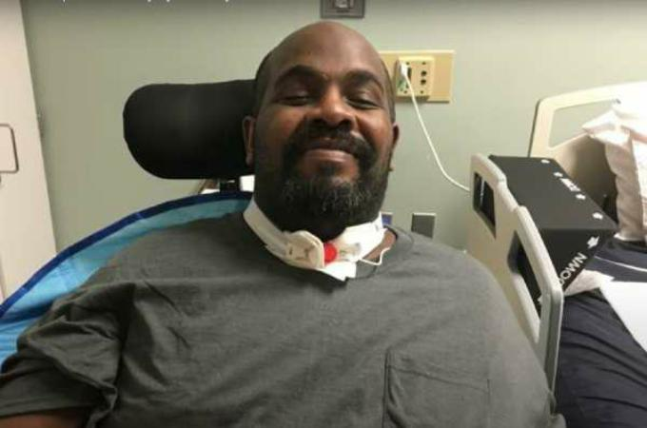
Impacts of Disasters on People with Disabilities
“Black Disabled Man Dies from COVID-19 After Texas Hospital Refused to Treat Him”
Michael Hickson
Photo credit: https://www.catholicnewsagency.com/news/disabled-man-dies-after-texas-hospital-withheld-coronavirus-treatment-55434

Slide 6
Emergency Management: A System of Systems
Emergency
Management
Public Health
Federal
One size does not fit all – every state, region, and local community operates differently
ALL have plans + emergency roles
Higher levels don’t necessarily oversee or control lower levels
Higher levels are supposed to coordinate with lower levels
Overlap is inconsistent between geographic areas and levels
Regional-State
State
Regional-Local
Local

Slide 7
Prepared4ALL Program Components
1. Online Course
2. Partner (Affiliate) Town Hall Meetings (3rd Wednesday, 1pmET-2pmET)
Planners and others welcome!
3. Student and Trainee Disability Inclusion Coaches

Slide 8
Prepared4ALL developed based on:
Emergency and public health preparedness planner survey (61 respondents)
Key informant interviews with experts (5 interviewees)
300+ resources scanned (trainings, informational documents, tools, templates, webinars, reports)​
Lit review
Key finding: Limited info about the “how” and the “why”

Slide 9
We Asked Emergency Managers and Public Health Preparedness Personnel About Disability Inclusion....
Community members with disabilities were ranked as the most useful resource for local emergency planning, but only 25% of respondents reported engaging them as a resource
Disability community often lacks context on:
Emergency planning process and emergency management system
Emergency manager and public health preparedness roles
Local government planners often lack context on:
Legal obligations under ADA and meeting access and functional needs during emergencies
Including people with disabilities in whole community planning
Local government staff often feel short on time, money, staff but are open to partnerships with the disability community-they just may not know how to engage

Slide 10
Emergency Managers & Public Health Preparedness Personnel Tell Us
“It's a two-way street. We need to keep in mind about people with disabilities and they need to make sure local emergency management knows what their needs are.”
“Include emergency managers in the regular planning for organizations that support” people with disabilities
Involve local emergency managers. Don't go around them.”
“There is typically very little in the way of dialogue between EMs and these types of organizations. It would be hugely beneficial for these groups to seek out EMs and begin discussions about inclusiveness.”
(Emergency Managers and Public Health Preparedness Planners surveyed October 2020)

Slide 11
Local emergency planning is better when it’s Prepared4ALL…

Slide 12
Prepared4ALL in Action: Emergency Dispensing Site
The Action Team meets with the public health planner before the clinic to confirm whether the clinic will be 4ALL, asking:
(1) Accessible space?
(2) Inclusive clinic process?
(3) Accommodations?
(4) Accessible communications?
(5) Inclusive philosophy?
(6) Cultural competence?
(7) Awareness of community needs?
After the clinic they work together to create an After Action Report to record lessons learned.
Notes:
Here’s an example of the Prepared4ALL approach in action. Suppose your community runs a seasonal flu vaccine clinic. The city website posts the flu clinic plan and a disability organization sees that there are potential access and inclusion issues.
P Pinpoint
Pinpoint the inclusion issue: Flu clinic plan is not inclusive. Pinpoint local EM and PH agencies: You check the local government website and find the contact information for the local public health department which runs the flu clinic. You’re surprised to find that there is a Health Office which is part of the Land Management Department.
R Relate
You think about local organizations with potentially related interests concerning the flu clinic. You contact food pantries which serve many people with disabilities, houses of worship, the local community health center and Center for Independent Living. The group meets to being thinking about how to approach the local Health Office.
E Engage
At the meeting the group discusses the local public health system and Americans with Disabilities Act issues with the current flu clinic plan. The group makes a question list about the flu clinic plan and a strategy to engage with the Health Office.
P be Positive
The group, now a Prepared4ALL Action Team completes the Prepared4ALL online training. The Team reviews the flu clinic plan and finds more gaps. They start a list of clinic plan gaps with potential solutions that focus on the positives like community strengths, resources, and organizational strengths.
A Advance opportunities
A Team member shares that her sister is friendly with a local public health nurse-she’ll ask her sister to make a connection. Maybe the nurse can link the Team to the local public health planner.
R Reflect
The Team reflects on their work to date by answering the Prepared4ALL Reflection Questions. They realize that so far things are moving forward and they have a potential connection in the public health department. As a group they pretty easily found access and inclusion gaps and developed tentative solutions. They assumed there was a big Public Health Department, which was wrong. There is a small public health office in an unrelated department. They think about potential issues: (1) In such a small office will they be able to make plan changes quickly? (2) Will plan changes need to get approved by a Department that doesn’t know about disability issues?
E Envision
The Team and public health planner (who has many responsibilities) meet to talk about the flu clinic plan gaps. They envision a what a successful inclusive flu clinic would look like. Then they discuss specifics. There is no design to set up the clinic space in a physically accessible way. The Team shares an article from the Prepared4ALL website that gives an example of an accessible set up. Using the article as a guide the planner agrees to reconfigure the space. The discuss whether clinic messaging is accessible. The Team shares information about plain language and alternate communication formats and offers to review the current messaging and make suggestions about communication access and inclusive language. The planner welcomes the offer of help and implements many of the suggestions.
D Deploy
The flu clinic happens as planned, with some of the suggested modifications. There is informal data collection about, among other things, the user experience, messaging, physical access, and accommodations, etc. While everything wasn’t perfect and there were glitches it was a success. The planner keeps notes of what went well and what could be improved. The planner now wants to work with the Team for the next year’s clinic and for an upcoming COVID-19 vaccine clinic.
4ALL
The Action Team meets with the public health planner before the clinic to confirm whether the clinic will be 4ALL. Together they ask Same Time Access to Everyone (STATE) questions: (1) Accessible space? (2) Inclusive clinic process? (3) Accommodations? (4) Accessible communications? (5) Inclusive philosophy? (6) Cultural competence? (7) Awareness of community needs?
After the clinic they work together to create an After Action Report to record lessons learned.
Originally designed for local disability organizations, the Prepared4ALL framework could also easily be used by local public health planners as they make outreach to disability and other community organizations.

Slide 13
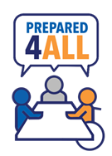
Community of Partners
National
Advisory Committee
Subject Matter Experts
Program Model
Town Halls
Local Disability Organization Affiliates
(monthly)
Prepared4ALL Whole Community Online Training (pilot testing)
Disability Inclusion Coaches (UCEDD/LEND trainees, Public Health)
Local Prepared4ALL Action Teams (Collaboration)
Partnerships with Local Emergency & Public Health Preparedness Planning Departments

Slide 14
Community of Partners Advisory Committee
National
Advisory Committee
Subject Matter Experts
American Network of Community Options and Resources (ANCOR)
Family Voices National
Florida Disability and Health Program
Jewish Family Service, Houston
Mental Health America
MoveUnited
National Association of Health Centers (NAHC)
Network of Jewish Human Service Agencies
Pacific ADA Center
SARTAC
TASH
The Arc
UCEDDs: Puerto Rico University, University of Cincinnati, Texas A&M

Slide 15
Subject Matter Experts
Kelly Israel, Autistic Self Advocacy Network
Bob Williams, Communication First
Vincent Siasoco, Metro Community Health Centers (FQHC)
Billy Altom, Association of Programs for Rural Independent Living (APRIL)
Aaron Cignarale, Monroe County Public Health Dept (NY)
Matt Weinburke, DrPH, American Public Health Association (APHA), PHEHP Treasurer, USPHS, CAPT (Ret)
Jacqueline Nguyen, International Association of Emergency Managers Access & Inclusion Chair

Slide 16
Subject Matter Experts
Kandra Strauss-Riggs, National Center for Disaster Medicine and Public Health
Justice Shorter, National Disability Rights Network
Roberta Carlin, American Association on Health and Disability
Row Lew – Asian Pacific Partners for Empowerment, Advocacy, and Leadership (APPEAL)
Meg Ann Traci, PhD Research Associate Professor – The Rural Institute for Inclusive Communities, University of Montana

Slide 17
Prepared4ALL Online Training: Whole Community Inclusive Emergency Planning

Slide 18
Prepared4ALL Whole Community Emergency Planning Online Course
Online Training
Format: Role play simulation based. Highly interactive. Applied learning.
 | Topics
1 | Welcome to Disasterville: The Prepared4ALL Process and COVID-19 Testing
2 | The Prepared4ALL Process in Action: Emergency Dispensing Sites/COVID-19 vaccines
3 | The Effects of Disasters and COVID-19 on People with Disabilities
4 | The American Emergency Management System
5 | Disability Demographics, Community Living, Communication and Accessible Meetings: What Local Emergency Planners May Not Know
6 | The Americans with Disabilities Act and Disasters and Pandemics
7 | Whole Community Emergency Planning (including AFN and CMIST)
8 | Community Stakeholder Meeting How To (including a workbook guide)
Notes:
Our community of partners and our research informed our development of an 8 lesson online course. It’s now available online for free at our website. Each lesson takes up to an hour to complete. Completing all 8 lessons leads to a certificate. While focused on disability organizations, the lessons are also appropriate for emergency and public health preparedness planners.
There are 2 ways to complete the course: (1) Complete all lessons in order to receive a certificate; or (2) Choose which lessons to complete. The course is available 24/7 and there is no time limit to complete a lesson or the whole course. You go at your own pace.
During the course the learner learns about:
The Prepared4ALL process and strategies
How to apply the process and strategies to COVID-19 testing and vaccine distribution
The negative effects of disasters and COVID-19 on people with disabilities
The American emergency management system and local emergency plans
Topics that planners may need more information about: local disability demographics, community living, accessible and respectful communication, accessible meetings
The Americans with Disabilities Act and disasters and pandemics. Topics include ADA requirements relating to physical and program access and effective communication, COVID-19 and ADA issues, service animals and ways to discuss the ADA that might resonate with emergency and public health preparedness planners.
Whole community (inclusive) emergency planning; access and functional needs and the related CMIST framework
How to hold a community stakeholder meeting to identify and close gaps in the local emergency plan. And how to use a workbook we developed to guide the meeting.
At the end of the course the learner receives a Resource List and a workbook guide for assessing local emergency plans. For each lesson there is also a learning agenda, outlining the lesson, with space for notetaking.

Slide 19
Certificate Training or Lessons “A La Carte”
Available anywhere, any time at your own pace:
Complete all 8 lessons to earn a certificate, OR
Choice based on your interests and needs
A La Carte Suggestions:
Inclusive emergency planning how to: Lessons 7 & 8
Disability demographics, communication and accessible meetings: Lesson 5
Background on the emergency management system and ADA requirements: Lessons 4 & 6
Disaster & COVID-19 impacts and legal rights: Lessons 3 & 6
Prepared4ALL approach-Engagement/collaboration strategies: Lessons 1 & 2

Slide 20
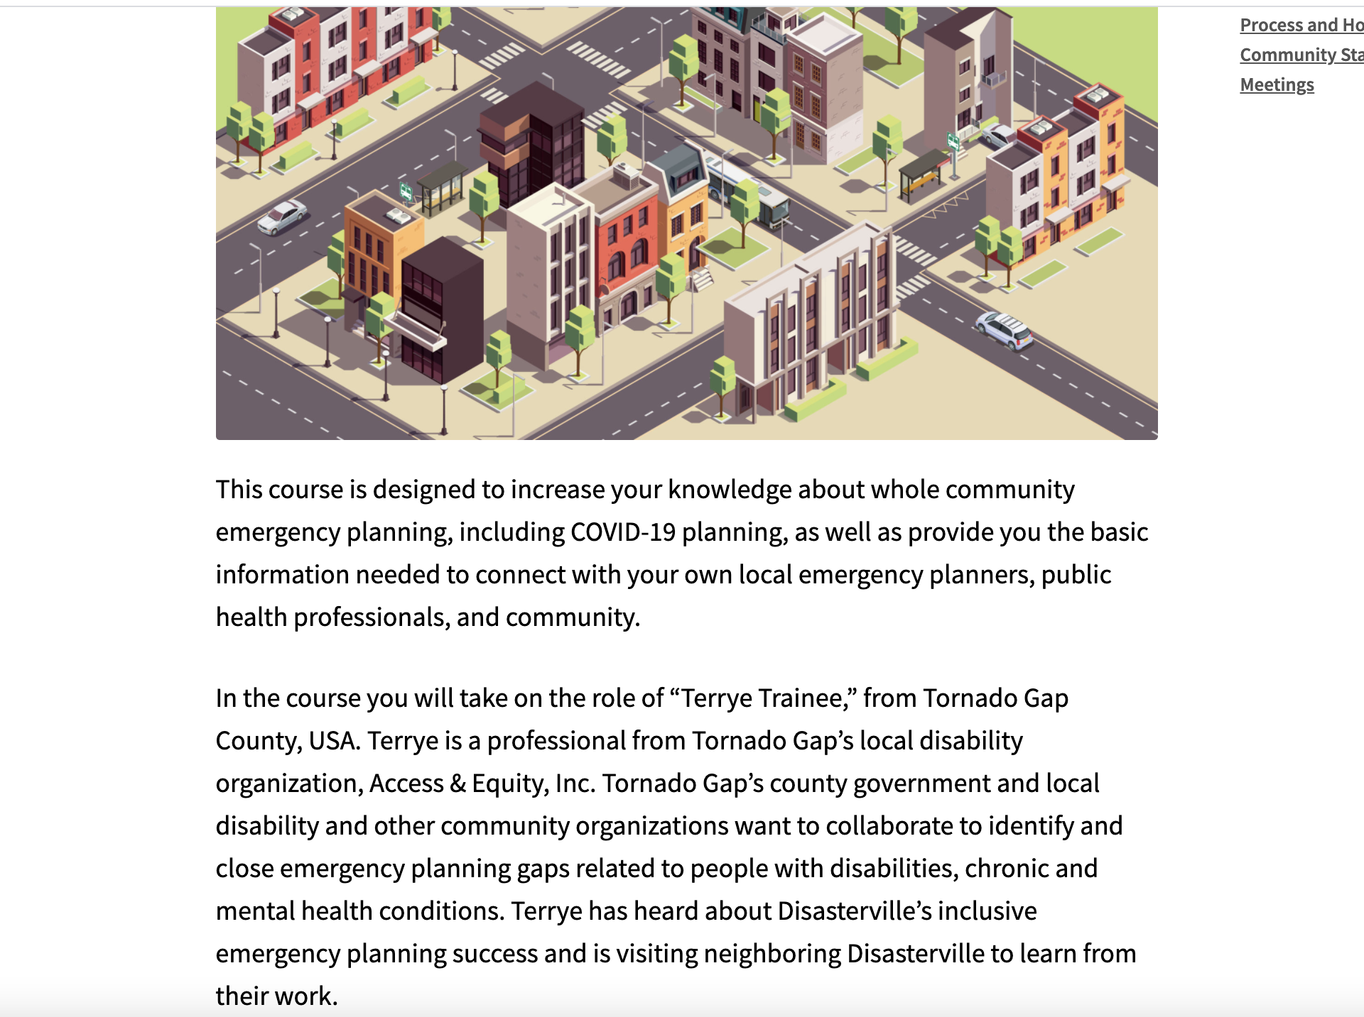

Slide 21
Notes:
The last part of the course describes how to hold a specific kind of emergency planning meeting, one we call a Community Stakeholder Meeting. At a Community Stakeholder Meeting local emergency and public health preparedness planners meet with residents including people with and without disabilities, disability organizations and representatives from other community-based organizations plus the local action team, if any.
Together they use this workbook to guide a process of identifying strengths and gaps in the local emergency plan. In addition to looking at the actual plan, they think about what happens in practice. (We all know that often what happens in practice may not be described in the plan and what is written in the plan may not happen in practice.)
Then they follow a 3 step process: Where Are We Now? identifies gaps. Where Do We Want To Be? sets priorities to close those gaps. And How Do We Get There? is about making an action plan to close the gaps.
The group follows the workbook through the meeting and at the end of the meeting the community will have a collaboratively developed action plan to use strengths to close gaps.
This process and the workbook guide were successfully piloted a number of years ago in Massachusetts. All of the participating communities identified at least 5 gaps related to inclusion in the local emergency plan and all identified a strategy to close those gaps. A typical Community Stakeholder Meeting takes about 3 hours to complete. Participant satisfaction with the meetings was very high.

Slide 22
Prepared4ALL Affiliates: Local Disability Organizations Form Action Teams

Slide 23
Prepared4ALL Local Disability Organization Chapters/Affiliates roles:
Town Halls Local Disability Org Affiliates
Local Prepared4ALL Action Teams (Collaboration)
Increase emergency preparedness knowledge and self-efficacy
Form Action Teams with other community-based organizations
Learn new collaboration and problem-solving strategies
Identify and connect with local emergency planning efforts
Build partnerships with local emergency and public health preparedness planners
Expand their networks
Strengthen community outreach and expand recognition

Slide 24
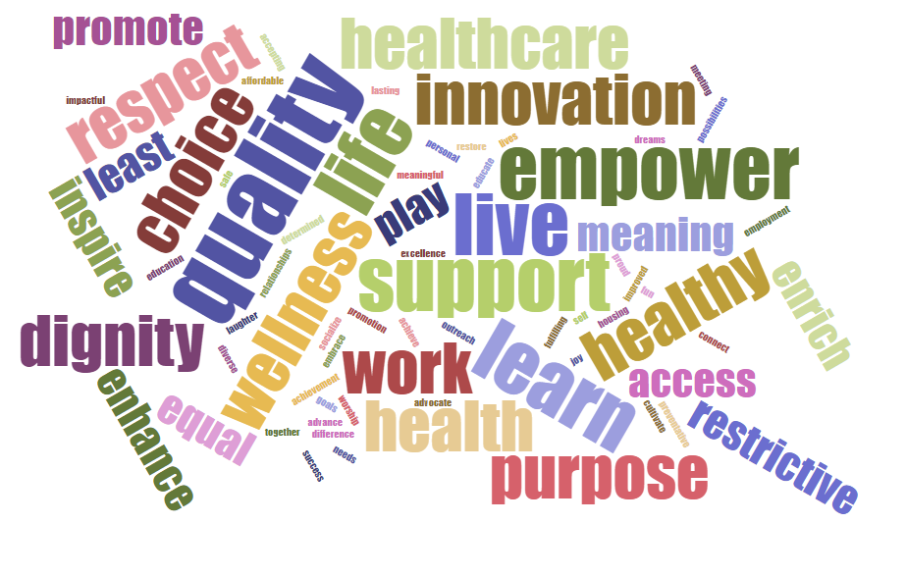
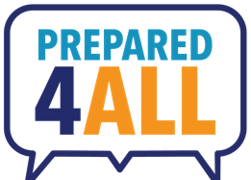
Connecting to Mission & Vision
Notes:
For disability organizations, it’s really important to connect their Prepared4ALL work with their organization’s mission and vision. The word cloud on the slide shows the results of an informal poll of disability organizations when asked what comes to mind when they think about their work.
Here are some words and phrases the organizations came up with:
Improve quality of life
Empower
Innovation
Support
Respect & Dignity
Independence
Health & Wellness
Live, Work, Learn, Play
Enrich & Enhance
Notice that involvement in community emergency planning relates to all of these terms

Slide 25
Getting Started – Outreach Guide
Ready to use resources to begin making outreach to your local emergency managers and public health professionals http://bit.ly/AffiliatePitchKit
Local Outreach One-Pager
Elevator Pitch
Outreach Telephone Guide
Talking Points for Engagement
Finding your Local Emergency Planning Agencies
Organizational Strengths Assessment
Communication Toolkit
Resources & Referral Links

Slide 26
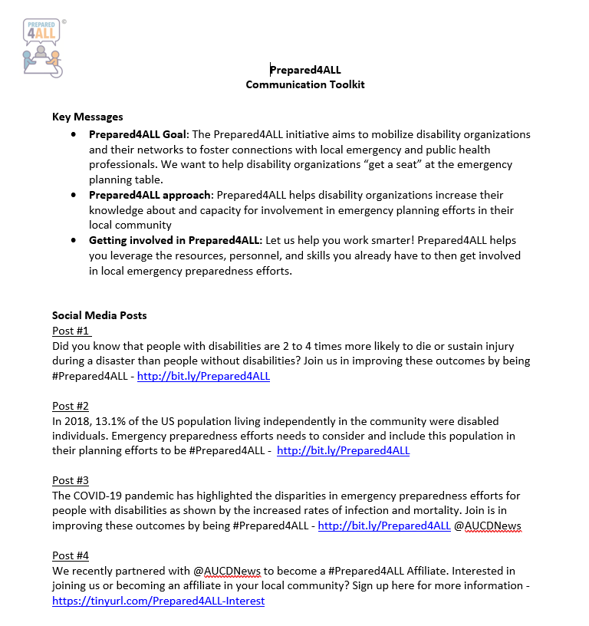
Communication Toolkit

Slide 27
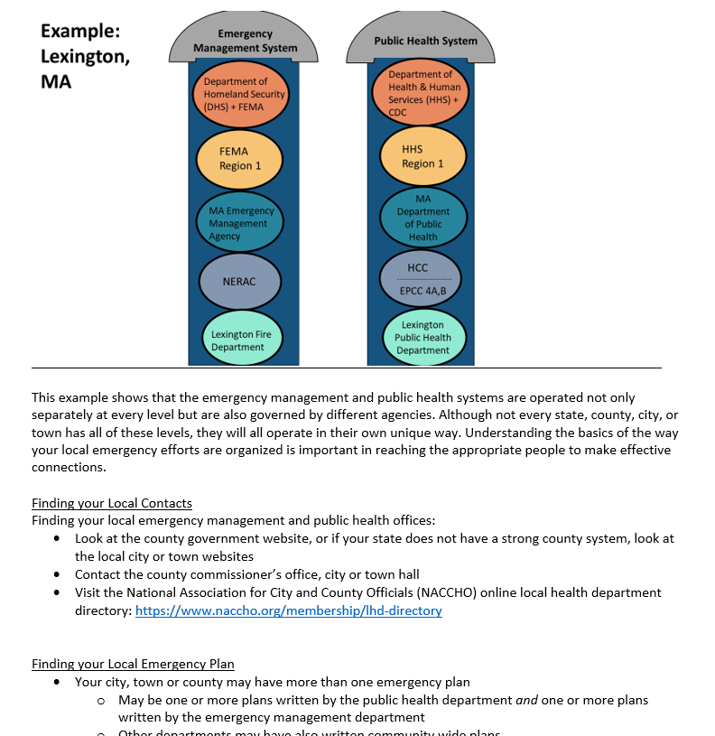
Finding Your Local Emergency Planning Agencies

Slide 28
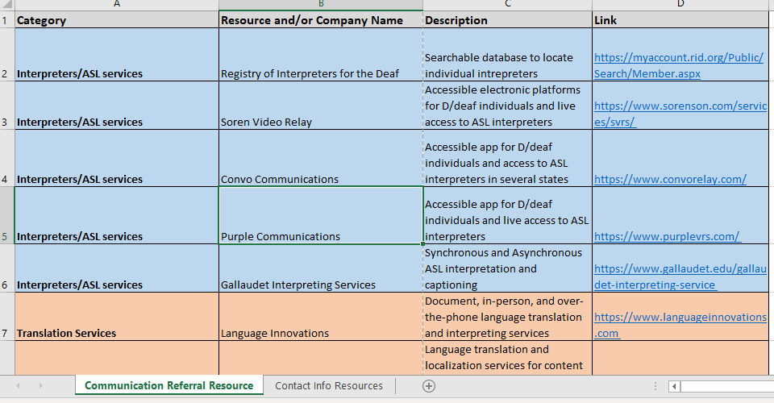
Resources & Referral Links

Slide 29
Disability Inclusion Coaches: Training, Research, & Practice

Slide 30
Disability Inclusion Coaches: Trainee role to support local affiliates and community efforts
Complete the online training
Disability Inclusion Coach Townhalls: skill-building, networking and problem-solving
Support local affiliates through guiding inquiry (coaching)
Conduct responsive research
Learn more: https://nationalcenterdph.org/our-focus-areas/prepared4all/what-is-a-prepared4all-disability-inclusion-coach/

Slide 31
The Prepared4ALL Difference
Audiences
Disability organizations
Emergency and public health preparedness planners
Approach
The “how” and the “why”
Strategies to build engagement, collaboration capacity (the Wheel)
Informed by experts and well-known successful public health approaches
Engagement and collaboration tools
Peer to peer support and problem solving (the Town Hall meetings)
Student and trainees support local EP work today and build future sustainability

Slide 32
Prepared4ALL Outcome: Partnerships A “seat at the table”
Partnerships with Local Emergency & Public Health Preparedness Planning Departments
Will look different for each community
Examples:
Participate in a local emergency planning meeting (literally a seat at the table)
Submit comments on the local emergency plan
Work with partners to identify gaps in your local emergency plan and strategize about how to close the gaps
Share information about how to find qualified sign language interpreters for emergency shelters or vaccine dispensing sites
Review alerts, warnings, public education and other communications intended for the disability community

Slide 33
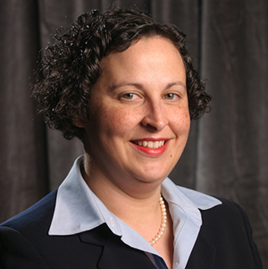
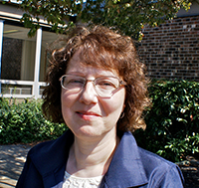
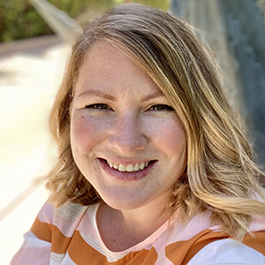
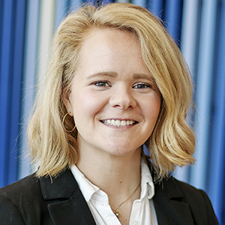
Acknowledgements: Our Team
Adriane Griffen, DrPH, MPH, MCHES
Sue Wolf-Fordham, JD, MPA
Lex Owen, MSW, PhD
Danielle Augustin, MS, CHWC

Slide 34
Disability Inclusion and Emergency Preparedness: AUCD, ASTHO and NACCHO Partnership and Collaboration
Adriane Griffen, DrPH, MPH, MCHES® Association of University Centers on Disabilities (AUCD) Sara Lyons, MPH National Association of County and City Health Officials (NACCHO) Cassandra Thompson, MPH Association of State and Territorial Health Officials (ASTHO)

Slide 35
Get Involved!
Take the FREE Online Training
https://bit.ly/Prepared4AllOnline
Lesson learning agendas
Resource list
Collaborative inclusive emergency planning workbook guide
Attend Monthly Affiliate (Partner) Town Hall Meetings (peer to peer sharing, support and problem solving, 3rd Wednesday 1pmET-2pmET)
https://bit.ly/MonthlyTownHalls
Emergency and public health preparedness planners and others welcome!
Involve Students or Trainees
https://bit.ly/Prepared4ALLCoaches

Slide 36
Prepared4ALL Lessons from the Field & Resources
We will share a link to a video with more information about our online training. That link will appear in the Pacific ADA Center and ADA National Network Learning Session webinar archive for this webinar.
In the video:
A student in the Prepared4ALL Inclusion Coach program describes her experience
A professional from a Prepared4ALL participating organization shares the impact of Prepared4ALL on her work and her organization
At the end of today’s slides look for 2 more slides with bonus resources

Slide 37
Thank you!
Email: Prepared4All@aucd.org
Join our Listserv:
https://bit.ly/Prepared4AllListserv
Learn more:
https://bit.ly/Prepared4ALL
Adriane Griffen, DrPH, MPH, MCHES®
AGriffen@aucd.org
Sue Wolf-Fordham, JD, MPA SWolf-Fordham@aucd.org

Slide 38
Bonus Resources
Online training lesson video previews https://nationalcenterdph.org/our-focus-areas/prepared4all/prepared4all-online-training-course/
Archived webinars https://nationalcenterdph.org/our-focus-areas/prepared4all/prepared4all-video-archive/

Slide 39
Public Health is for Everyone: www.phetoolkit.org

